Slide 1
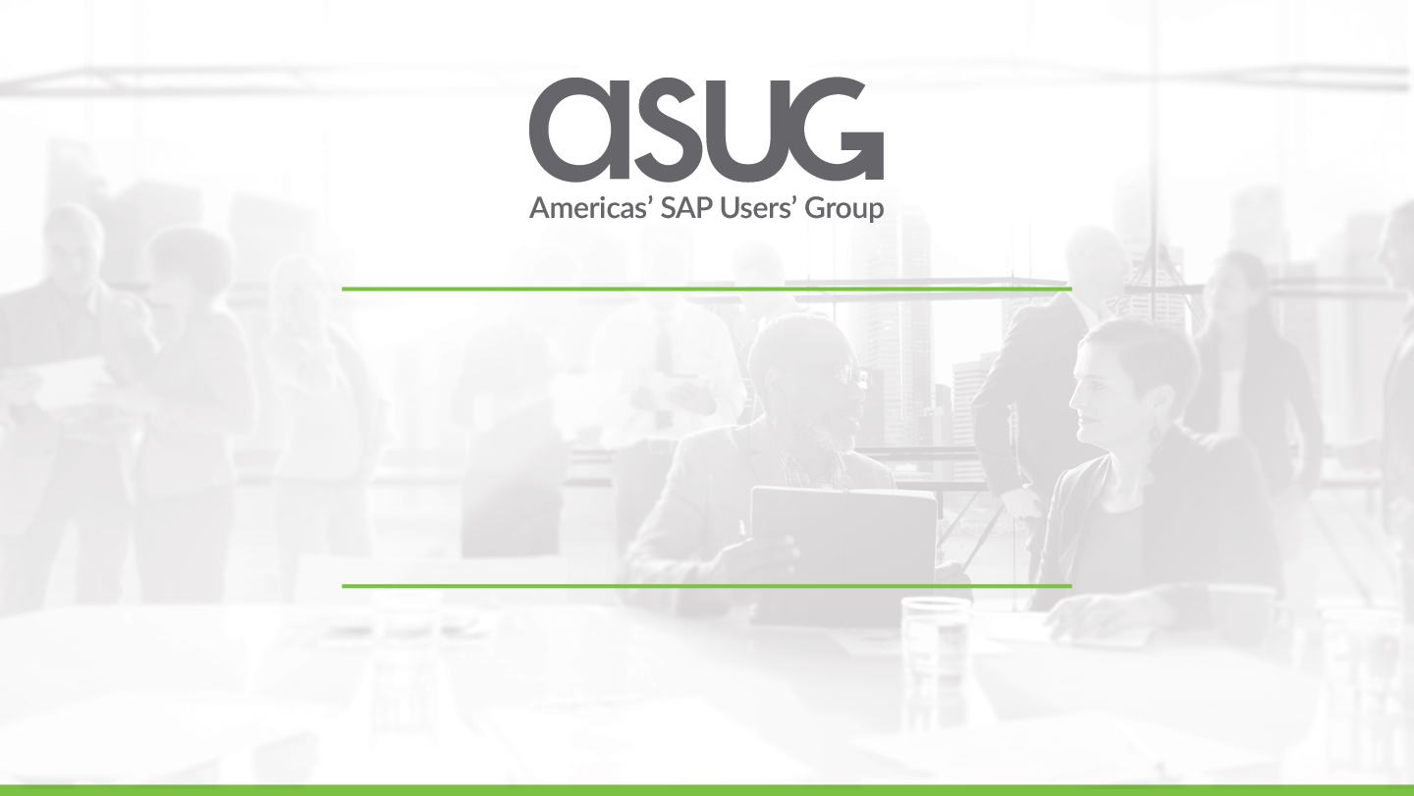
DevOps Automation for SAP:
How a leading communication technology provider is driving innovation
Christopher Hale & Syed Fahad
Basis Technologies

Slide 2



About The Customer
Global Telecomms leader:
120,000 employees
> 45,000 patents
Business focus:
Networks
Digital Services
Managed Services
Emerging Business:
5G
IoT
R&D

Slide 3
Why Change IT Methodology?
Respond Quickly to Market Pressures
Sharpen the Competitive Edge
Continuous Customer Satisfaction
OBJECTIVES

Slide 4
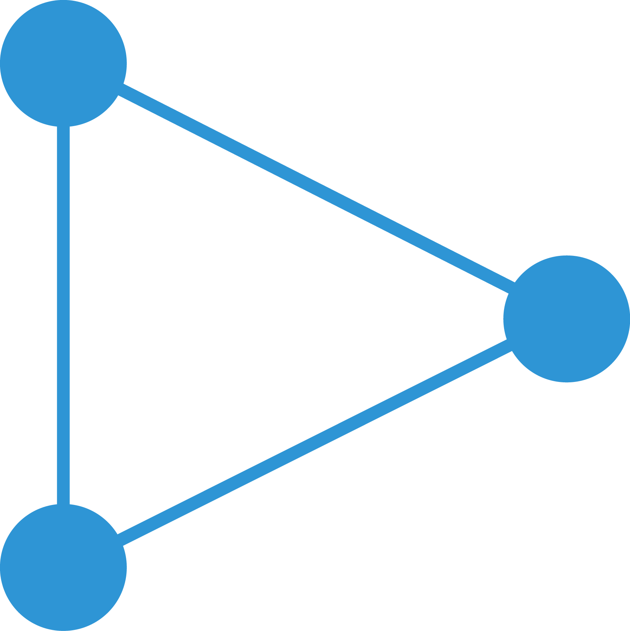
Evolution towards agile/DevOps
DevOps is built on agile principles and provides a platform for greater speed, versatility and agility
Waterfall
Agile
DevOps
Long pre-planned release cycles
Can be difficult to change direction
Business may wait a long time for delivery
Short & frequent releases
More responsive
Business gets new features faster
Testing, risk, impact and recovery time are low
Continuous delivery to business
Highly responsive
Automation reduce risks and improves quality
Greater business alignment & satisfaction
Improved productivity & efficiency

Slide 5
DevOps Project Objectives
Increase velocity of E2E delivery lifecycle
Deliver measurable Business Value quickly
Increase productivity
More Code
Reduce cost
Cost of poor quality
Cost of missing SLAs
Improve quality
Eliminate redundant manual effort
Automate everything!
Faster Feedback
First time right!
Component re-use
Eliminate Environment Configuration Issues
Cost of human error
Cost of manual processes
Software delivery
Release management

Slide 6
Challenges in DevOps Transformation
Solution Architecture
Cross-team Alignment
Human Dynamics
SAP
Tibco
Oracle
Ericsson Proprietary
Team Silos
Different Ways of Working
Different Tools
Different Delivery Processes
Ops-Enabled Delivery
Static Environments
Manual Environment Management
Manual Deployment
Manual Errors
Focused on Deliver, Deliver, Deliver
Stretched Thin
Myopic View of Delivery Process (not E2E)
Threatened by DevOps
15+ different systems...

Slide 7
DevOps Technical Strategy
Approach
Phase I
Build a CI/CD Pipeline to Automate Build and Deployment
Phase II
Containerize Apps
Use App Containers to Build Environments
Deploy to Containers as though they were servers
Phase III
Build Containers within the CI/CD Pipeline
Deploy Containers to Environments through and Orchestrated Delivery Platform
Implement a microservices strategy

Slide 8

Multi-App Domain Delivery (SAP disconnected)
Create business requirement
Build
Application Test
Integration Test
Deploy to Customer Environment
Continuous Integration build process
ERP
Single-domain Dev environment
Single-domain QA environment
Multi-domain QA environment (all apps)
Customer Production environment (all apps)
Single-domain Dev environment
Single-domain QA environment
Application 1
Application 2
Single-domain Dev environment
Single-domain QA environment
Application 3
Single-domain Dev environment
Single-domain QA environment
Application N
Single-domain Dev environment
Single-domain QA environment

Slide 9
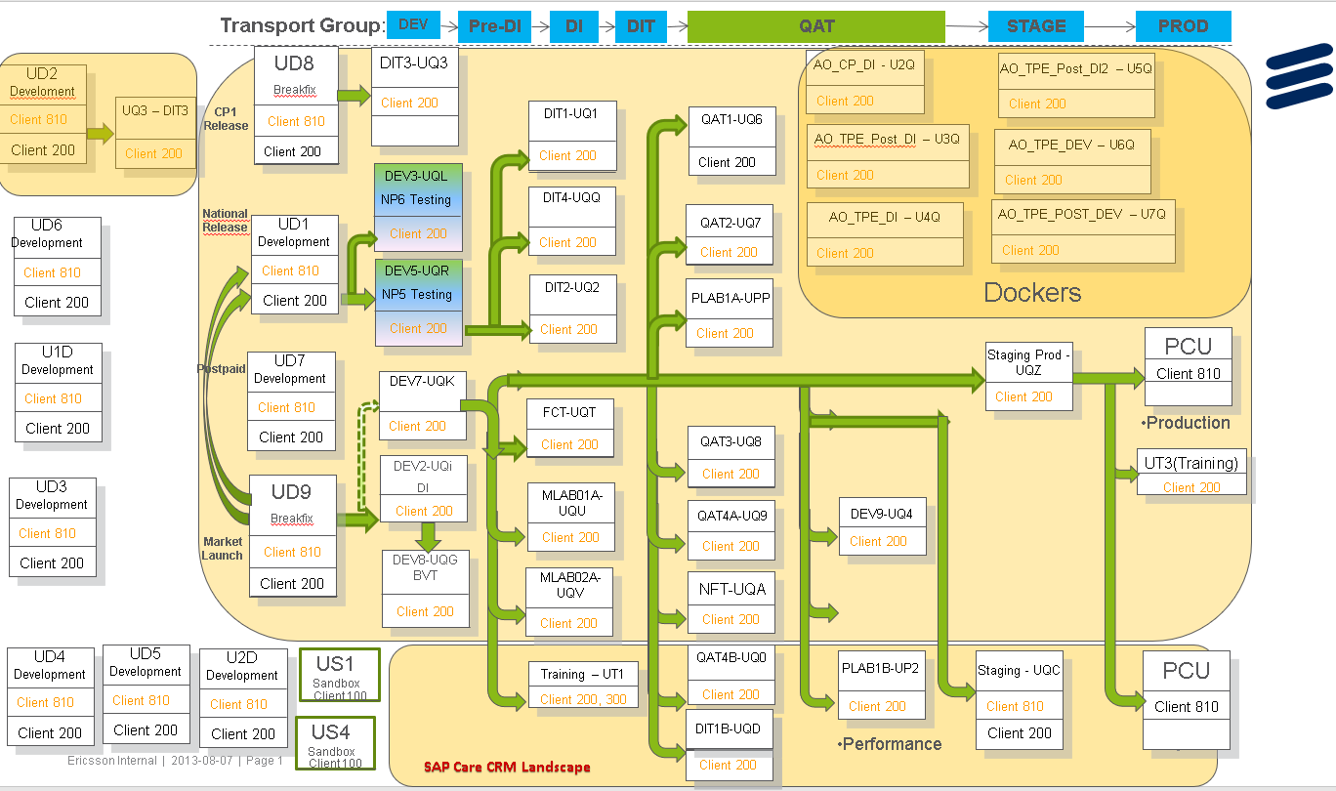
Complex, Multi-track SAP Landscape
Notes:
Transport path complexity
N+1 Problem

Slide 10
DevOps Technical Strategy: SAP Challenges
SAP = Black Box
Closed System
Code Dev
Source Control
Testing
Deployment
Merge Quality
Code Quality
Test Results
Deployment
Manual Effort
Environment Orchestration
Deployment
Non Standard
No Real Branching Strategy
Notes:
SAP arch. More complex that the rest of the software
What about……???

Slide 11

Solving the Problem
App N…
App 1
Automatic build, test, deploy
App 2
App 3
Notes:
What Ericsson realized what they wanted to achieve
Bridge tech and functional gap for CI/CD pipeline

Slide 12
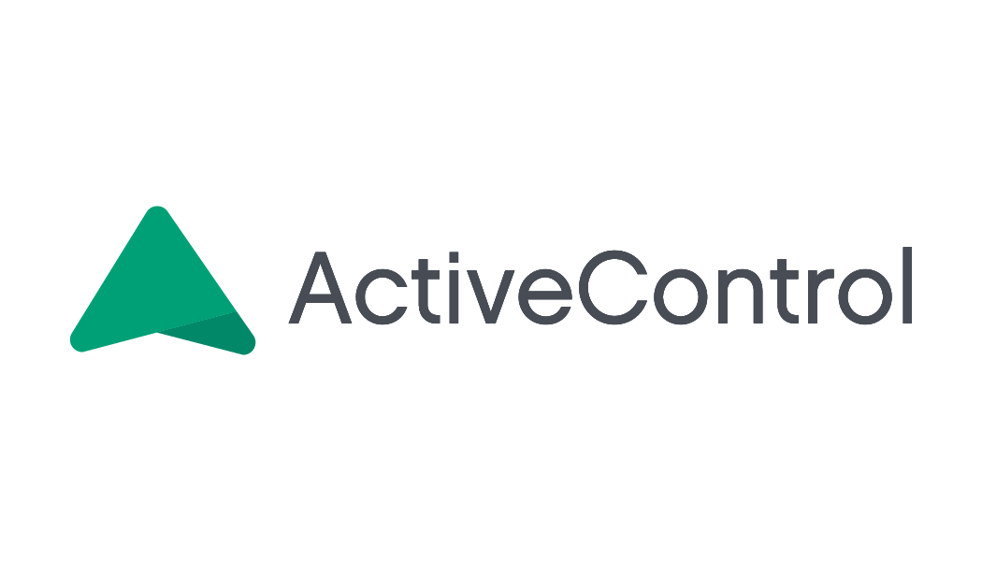
Solving the Problem: ActiveControl
App N…
App 1
Web
Automatic build, test, deploy
Supply chain
CRM
App 2
App 3
Notes:
We heard from Ericsson that they wanted to like other software solutions

Slide 13






Integrate Toolsets and Applications
Manage & Collaborate
Build
Test
Deploy
Run
Requirements & Backlog
Continuous Integration
Continuous Delivery
ITSM & Agile
Source Code & Version Control

Slide 14
Single-domain environment (e.g. SAP)
Multi-domain environment (all apps)
CI pipeline
Create business requirement
Check in SAP info (incl. Task ID)
Commit trigger
Validate Task ID
Deployment trigger
Trigger deployment
Deploy to single env.
Return deployment status
Return deployment status
Trigger single domain tests
Return test results
Trigger deployment
Deploy to multi-domain env.
Return deployment status
Return deployment status
Trigger multi-domain tests
Return test results

Slide 15
Achieving Multi-App Domain Delivery (with SAP)
Create business requirement
Build
Application Test
Integration Test
Deploy to Customer Environment
Continuous Integration build process
ERP
Single-domain Dev environment
Single-domain QA environment
Multi-domain QA environment (all apps)
Customer Production environment (all apps)
Single-domain Dev environment
Single-domain QA environment
Application 1
Application 2
Single-domain Dev environment
Single-domain QA environment
Application 3
Single-domain Dev environment
Single-domain QA environment
Application N
Single-domain Dev environment
Single-domain QA environment

Slide 16
Continuous Delivery in Action
Major telecom provider
Co-ordinated, automated deployments across 15 IT applications, including an N+10 SAP landscape
Seamless management of change across a dynamic SAP landscape
Continuous, on-demand delivery of up to 2,500 SAP transports in a 2-week period

Slide 17

Benefits of ActiveControl
Automatic, co-ordinated build, test and deployment of change (SAP and non-SAP)
SAP deployment in sync with other app domains
SAP deployment triggered automatically
SAP development is integrated into wider application delivery process
SAP team delivers quality KPIs to project branch
Enables tracking and coherence in delivery process
Faster business response and product rollout via frequent deployment of integrated, cross-application change

Slide 18










About Basis Technologies
We build software automation that enables our customers to optimize the way they run SAP.
We focus on bringing DevOps & Continuous Delivery to SAP environments
Global offices serving customer base of multi-national brands

Slide 19
Questions?
www.basistechnologies.com

Slide 20

Follow Us
Thank you for your time
Follow us on at @ASUG365

